Slide 1
REsources and SERvices VirtualizatiOn wIthout boundaRies
Benny Rochwerger
IBM Haifa Research Lab

Slide 2
Agenda
What
  The RESERVOIR VISION
Who
  The RESERVOIR Consortium
How
  The SOI Equation
  The RESERVOIR Project Structure
  The RESERVOIR Architecture

Slide 3
The RESERVOIR Vision
The Next Generation Infrastructure for Service Delivery
  Provide revolutionary foundation for a new European infrastructure where resources and services can be transparently and dynamically managed, provisioned and relocated like utilities – virtually “without borders”
  No single facility/provider/cloud can create a seemingly infinite infrastructure capable of serving massive amounts of users at all times, from all locations
    Federation of clouds
    Leverage the diversity factor to achieve economies of scale
    Leverage locality
  Analogies exists in areas outside IT services:
    Electrical power delivery: capacity can be shifted to guarantee supply and lower costs
    Roaming cellular communications: Talk wherever you are
“… today’s commercial clouds have not been open and general purpose, but instead been mostly proprietary and specialized for the specific internal uses (e.g., large-scale data analysis) of the companies that developed them. The idea that we might want to enable interoperability between providers (as in the electric power grid) has not yet surfaced …”
“…will move towards a mix of microproduction and large utilities, with increasing numbers of small-scale producers co-existing with large-scale regional producers, and load being distributed among them dynamically …”
There’s Grid in then thar Clouds - Ian Foster

Slide 4













Project Profile
3 Years FP7 project started in February
Budget: € 17 million
The consortium includes 13 partners from across industry, academia and standards bodies
Selected as a NESSI strategic project
  Networked European Software and Services Initiative is a
Architecture work-package fully at work
  First version of architectural spec. just released
Started working on building the testbed
  15 machines at UniMe, 4 machines at IBM (2 more on the way) and 8 machines on the way to UCM
Other work packages just got started
Come visit us at http://www.reservoir-fp7.eu/

Slide 5
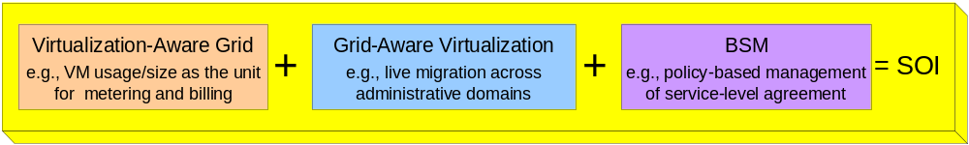
Approach
Focus on technologies that enable to build cooperating computing clouds
  Connect computing clouds to create an even bigger cloud
Integration of virtualization technologies with grid computing driven by new techniques for business service management ⇒ The Service Oriented Infrastructure (SOI) equation:
Building on this equation we will architect and implement a platform for supporting complex services, which
  Enables dynamic deployment of complex multi-tier services across heterogeneous administration domains
  Uses virtualization of servers, storage and network to allow migration without borders
  Supports service definition, SLA management, accounting and billing

Slide 6
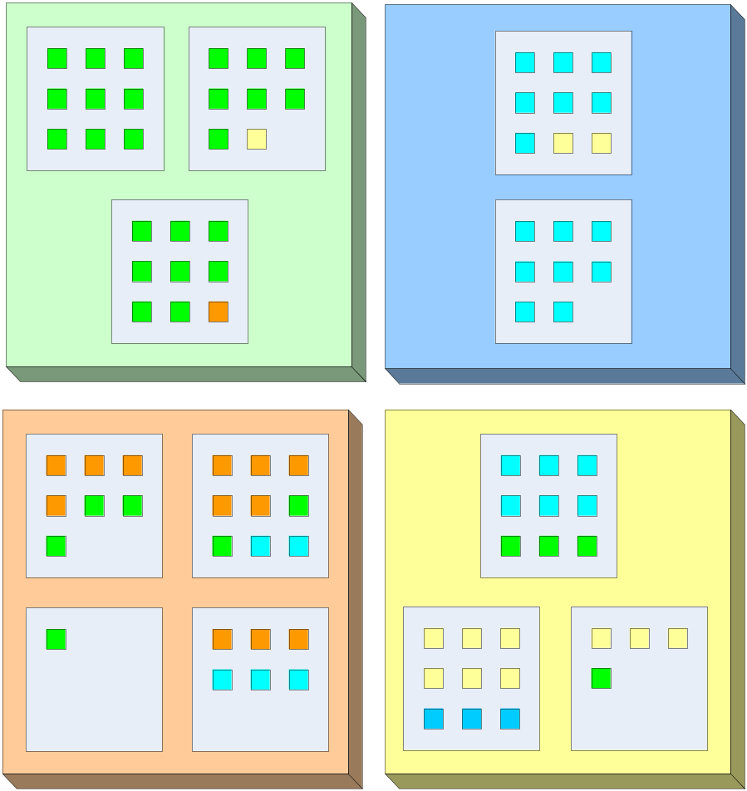
SOI: Grid Computing
Site
Physical
Resources
Process

Slide 7
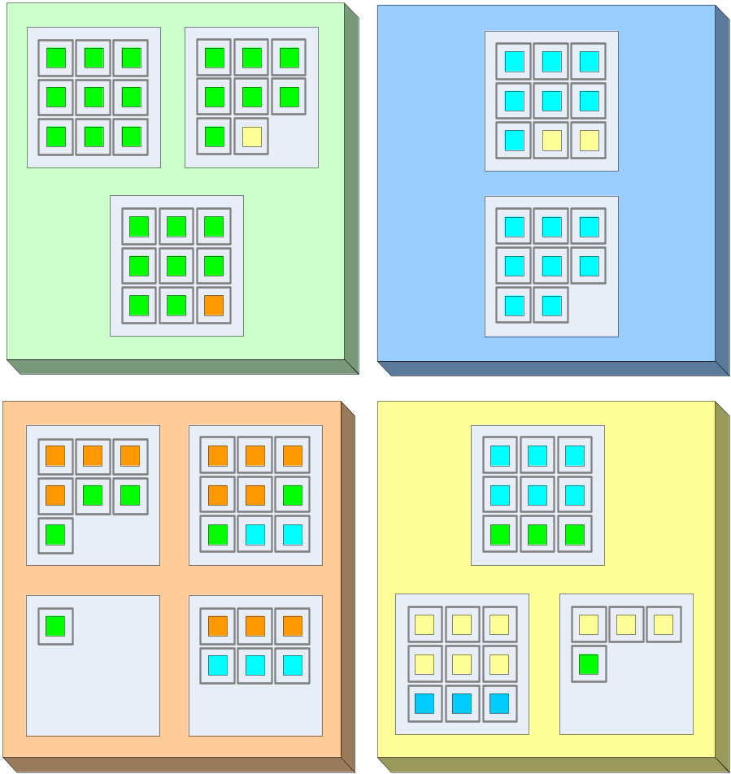
SOI: Grid Computing + Virtualization
Virtual Execution Environment (VEE)
Improved isolation, Relax dependencies, Well defined billing units

Slide 8

SOI: Grid Computing + Virtualization + BSM
Policy 1:
If possible keep VEEs from
the same organization in the
same physical box

Slide 9
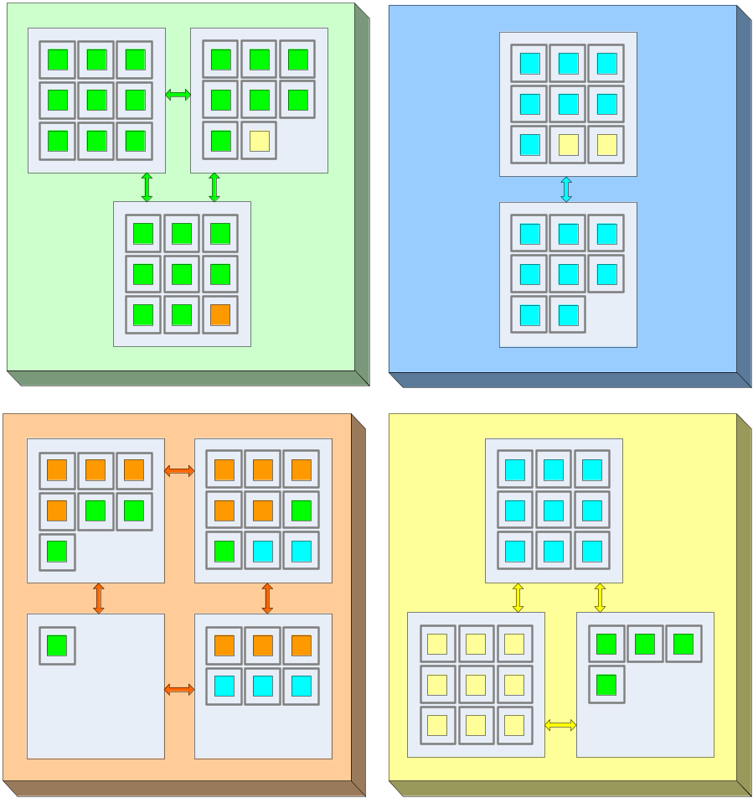
SOI: Grid Computing + Virtualization + BSM
Policy 1:
If possible keep VEEs from
the same organization in the
same physical box
Policy 2:
Turn off
underutilized
physical boxes

Slide 10
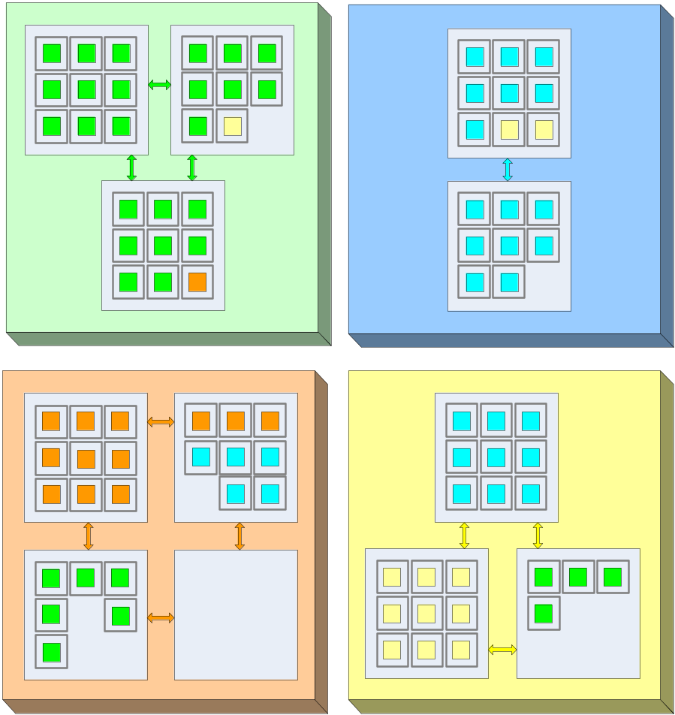
SOI: Grid Computing + Virtualization + BSM
Policy 1:
If possible keep VEEs from
the same organization in the
same physical box
Policy 2:
Turn off
underutilized
physical boxes
Local optimizations (within a single site): placement, power, etc.

Slide 11
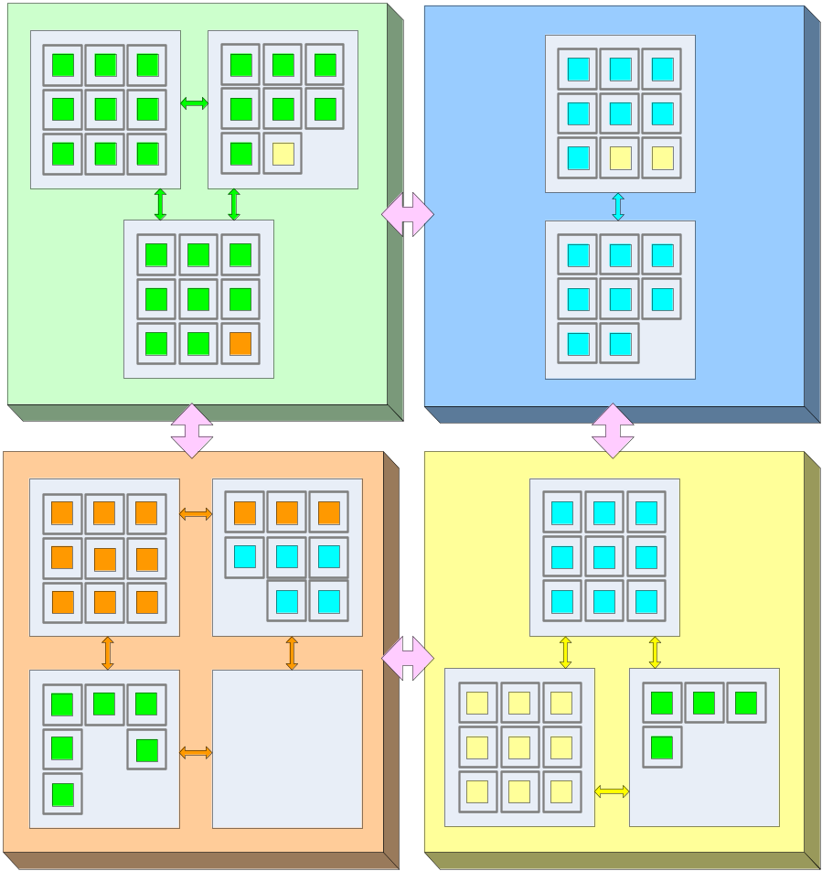
SOI: Remove Boundaries …
Policy 3:
If possible keep
VEEs in “owning”
organization

Slide 12
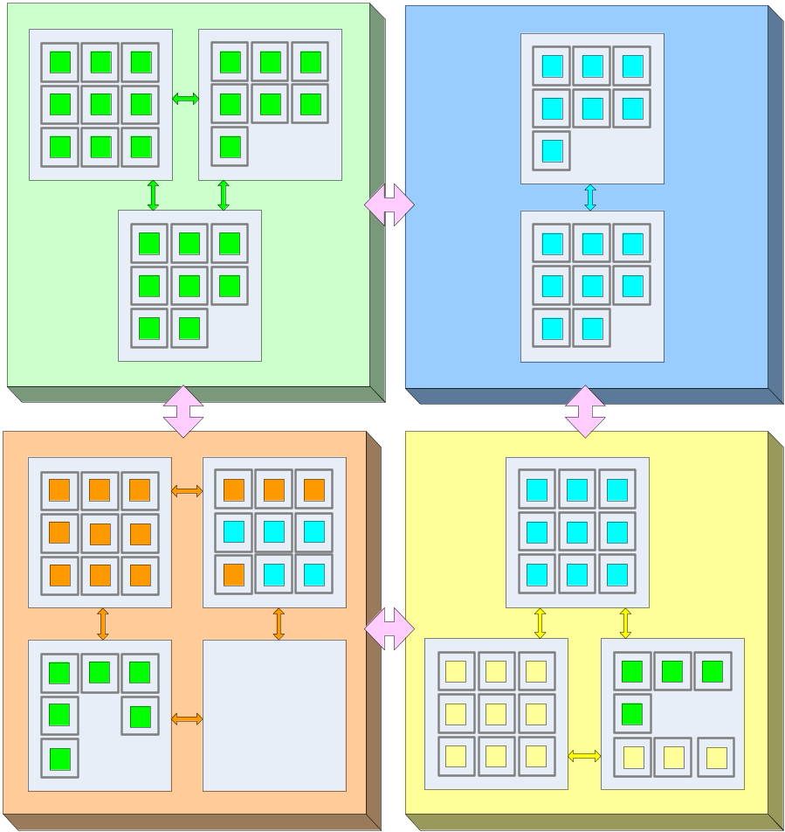
SOI: Remove Boundaries …
Policy 3:
If possible keep
VEEs in “owning”
organization
Policy 4:
If possible keep
VEEs in least number of external organizations

Slide 13
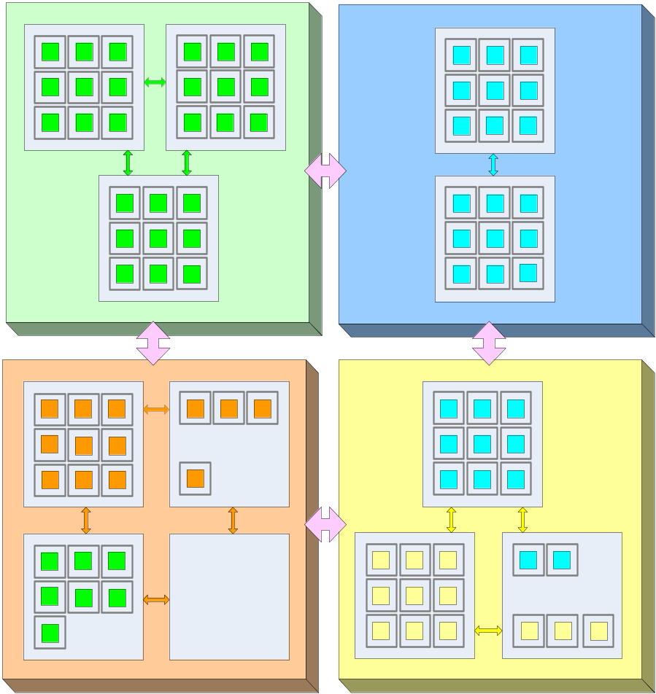
SOI: Remove Boundaries …
Policy 3:
If possible keep
VEEs in “owning”
organization
Policy 4:
If possible keep
VEEs in least number of external organizations

Slide 14
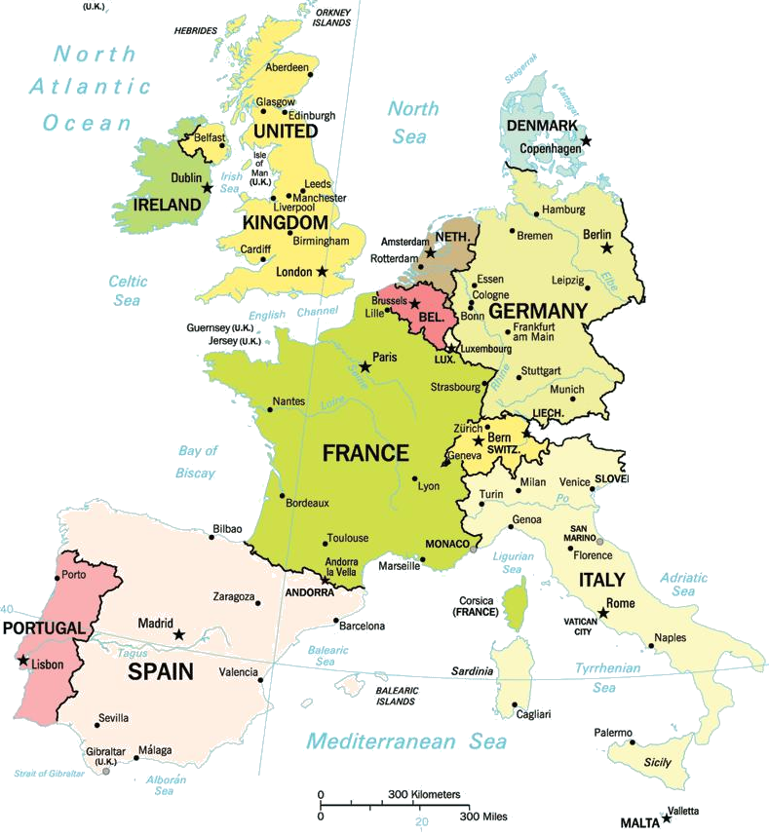
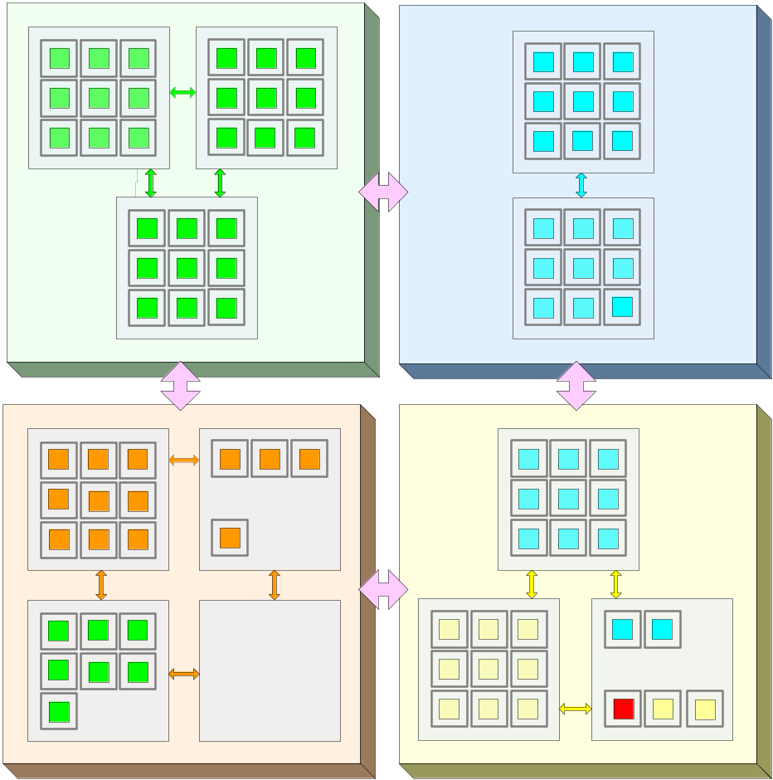
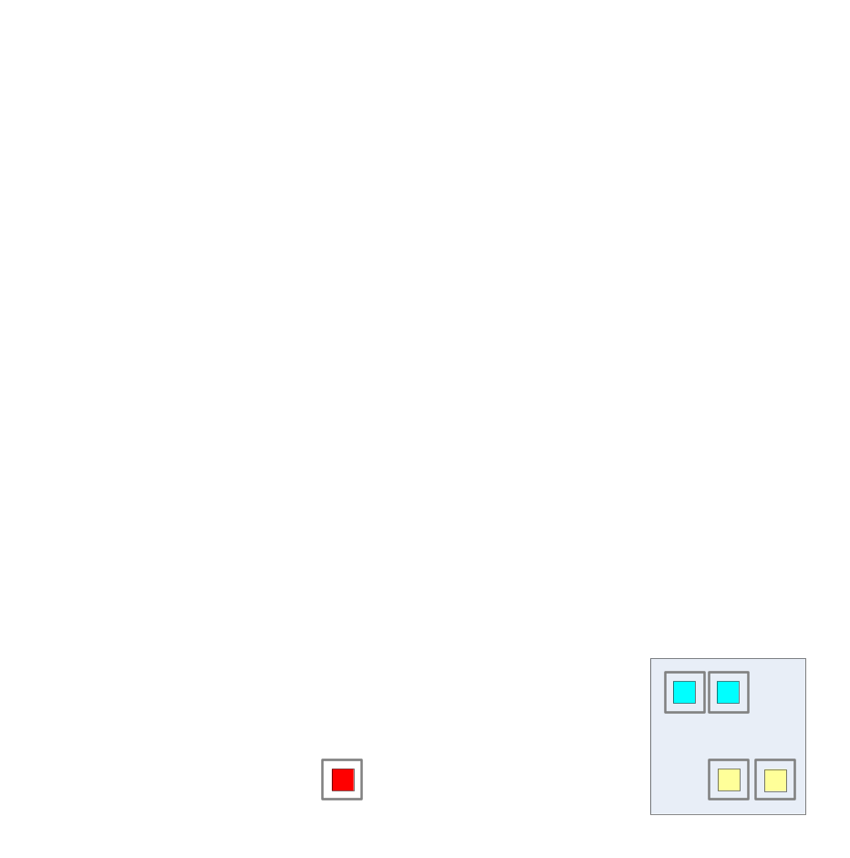

SOI: Remove Boundaries …
Policy 5:
“Follow” the service customer
Migration across sites ➔ Global optimizations: placement, cost, bandwidth, etc.

Slide 15
Challenges
From service (high level, business concepts) to infrastructure (low level, IT concepts)
  A service definition language that captures in functional requirements of the service
  Mapping of high level service requirements and metrics (e.g., response time) to infrastructure level requirements and metrics (e.g., CPU utilization)
Policy-based management across administrative domains (clouds)
  Multi-level SLA management (service consumer, services provider/s, infrastructure provider)
    Separation of functional responsibilities and collaborative reconciliation
  Service level utility analog of electricity power,
    Dynamically automatically hire additional 'power‘ from a another cloud
  Enable intra-site and inter-site workload optimization, HA and SLA management
The capability of creating fully isolated virtual organizations spread across geographies and management domains.
  Through an integrated approach to virtualization of servers, network and storage
  Introduce capabilities for mobility of virtual resources and services across different administrative domains, and for management of disparate virtualized environments
End to end performance of virtualized systems
  Identify “typical service workload” for which Reservoir-like infrastructure is advantageous
  Pinpoint causes of performance degradation, for the selected service workload(s), in virtualized environments
    Introduce service workload-specific optimizations to relevant virtualization layer

Slide 16
Project Structure
A4: Service Management (TID)
A6: Dissemination (CETIC)
A1: Architecture (IBM)
A5: Testbed and Scenarios (UniMe)
A3: VEE Management (UCM)
A2: VEE Infrastructure (IBM)

Slide 17
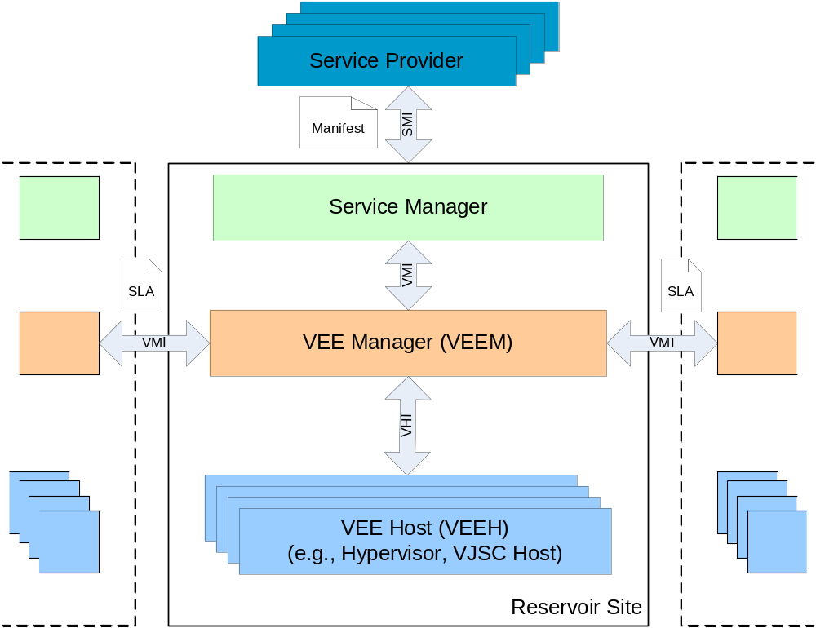
The Reservoir Architecture
Monitor service and enforce SLA compliance by managing capacity of Service Components (VEEs) or/and size of Service Tiers
Deals with translation/mapping of service concepts/metrics (response time) to infrastructure concepts/metrics (VEE size)
Monitor VEEs and find best VEE placement that meet constraint satisfaction problem
Deals federation of domains
Translates generic commands into command specific to the virtualization platform it abstracts
Setting and maintaining isolated virtual networks
Enables efficient and secure access to remote storage
Performance optimizations

Slide 18
Design Driven by Real-World Scenarios
Scenario 1: SAP business application (SAP)
  Business application oriented use cases and the opportunities to execute them on a flexible infrastructure.
Scenario 2: Telco application (TID)
  Hosting web sites that deals with massive access (e.g., the Olympics games)
  High degree of personalization and support for mashups
Scenario 3: Utility computing (Sun)
  Deploy arbitrary operating system and application stacks on remote resources. Provide secure and seamless access to them. Adjust resource allocation on-demand without the end user noticing disruption of service
Scenario 4: eGov application (Thales)
  Automatic adjustment of resources and domains cooperation

Slide 19
Summary
Very aggressive project to create the next generation infrastructure for services
  Bridge the gap between the services and infrastructure worlds
Based on the emerging paradigm of cloud computing but focus on technologies that enable to build cooperating computing clouds
  Explore, merge and extend technologies
    Grid computing
    Virtualization
    Business Service Management

Slide 20


